Slide 1

SMART HOMES
Adrián Moreno Martínez
03/12/2019 @ Tarragona Developers Meetup

Slide 2
What is a Smart Home?
“A dwelling incorporating a communications network that connects the key electrical appliances and services, and allows them to be remotely controlled, monitored or accessed.”
“Remotely in this context can mean both within the dwelling and from outside the dwelling.”
https://www.housinglin.org.uk/_assets/Resources/Housing/Housing_advice/Smart_Home_-_A_definition_September_2003.pdf

Slide 3
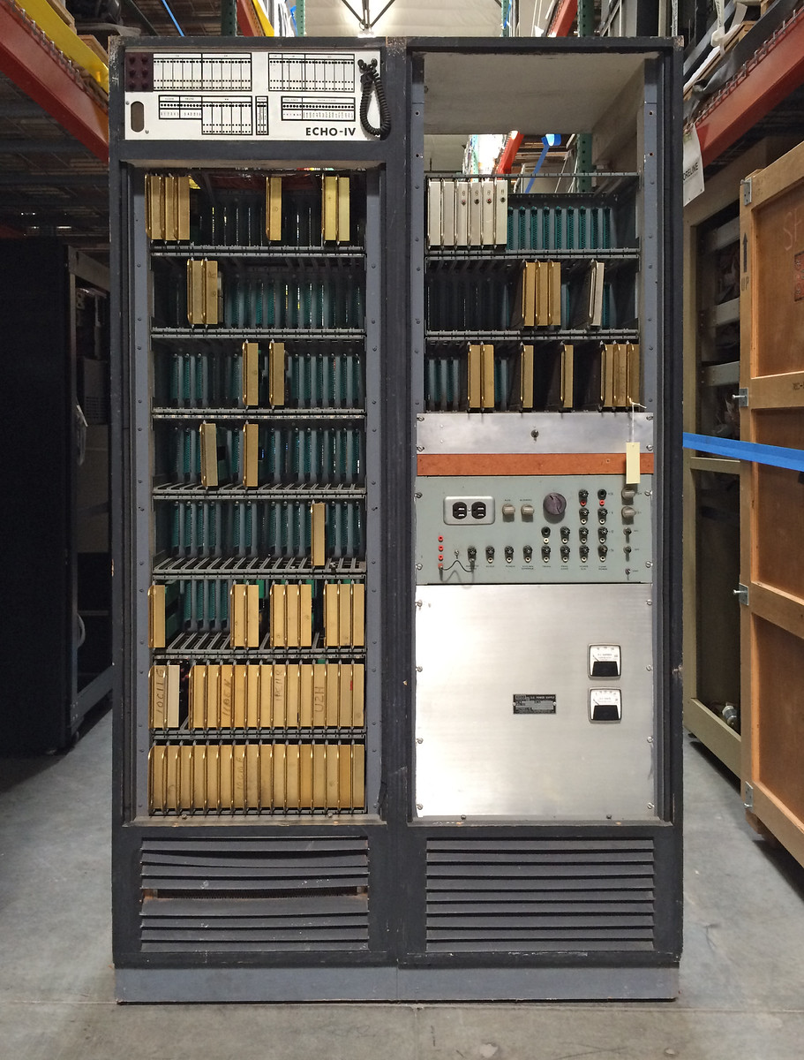
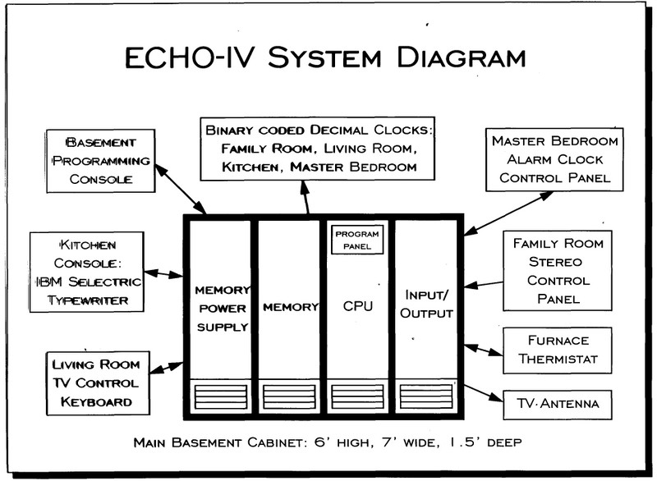
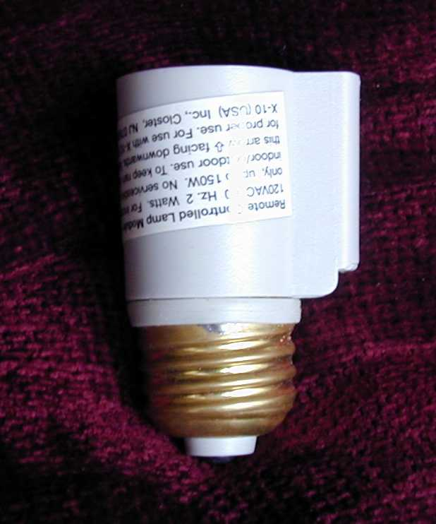
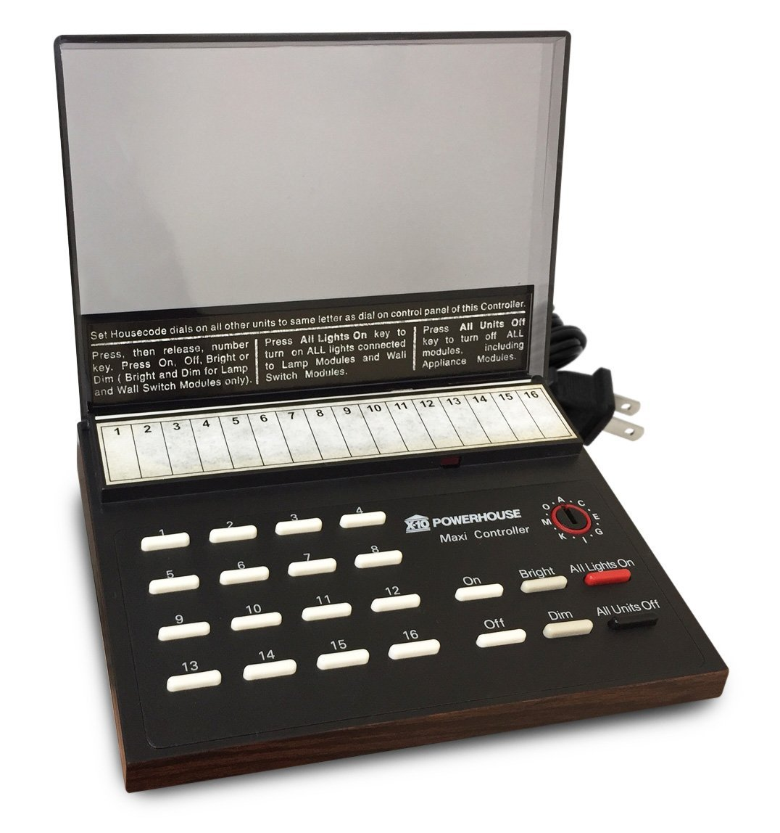
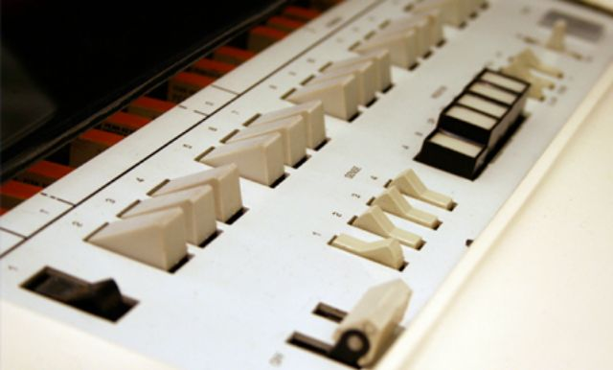
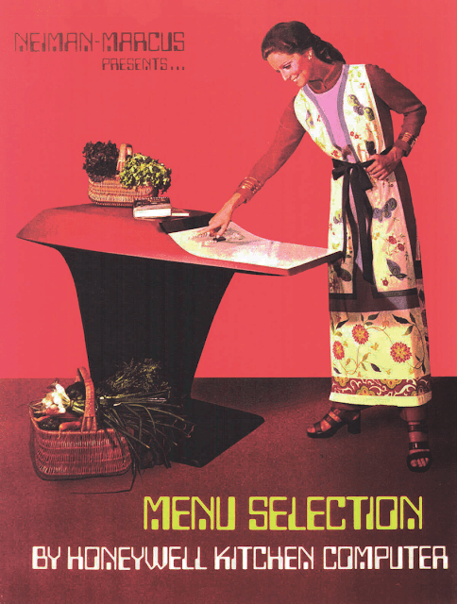
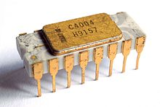
A bit of history
1901–1920: the invention of home appliances
1966: Echo IV, the first smart automation system
1969: Honeywell Kitchen Computer
1971: Intel 4004, the first microprocessor
1975: X10, the first general purpose home automation network technology
1991: gerontechnology
early 2000s: smart homes began to increase popularity

Slide 4
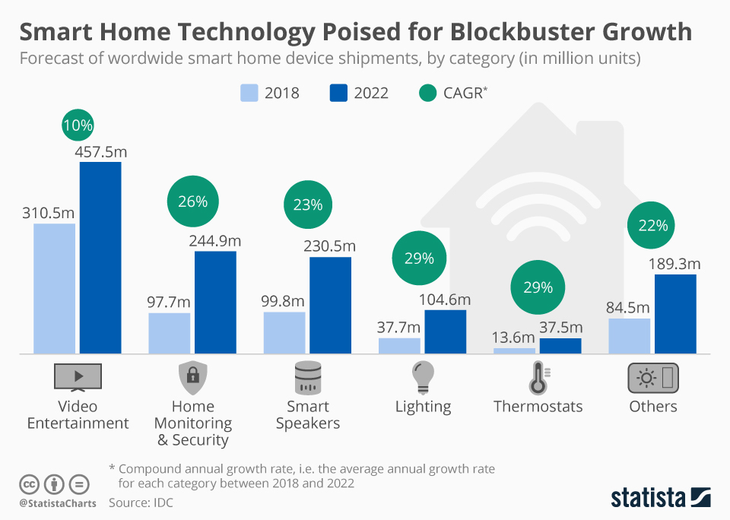

Slide 5
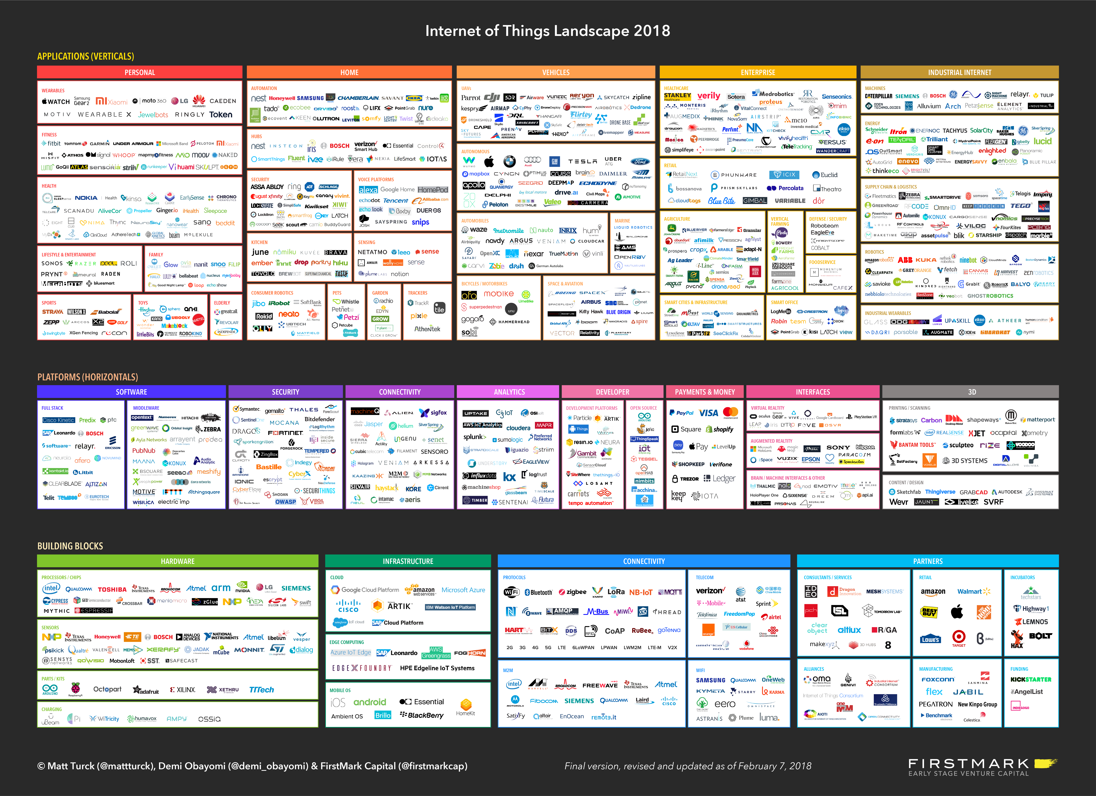

Slide 6
Challenges
Heavily fragmented platforms
Very few open and accepted industry standards
Hard to develop cross-platform solutions
Security
Privacy

Slide 7
Classification
Devices, or things
Central hub, or gateway
UI
Protocols

Slide 8





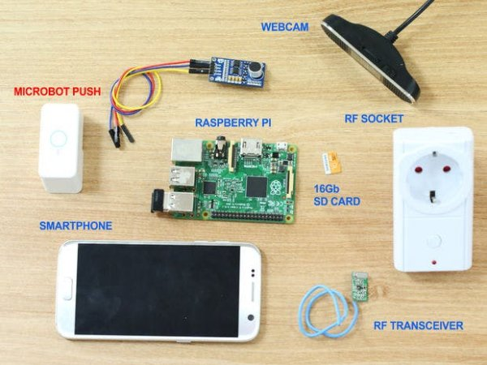
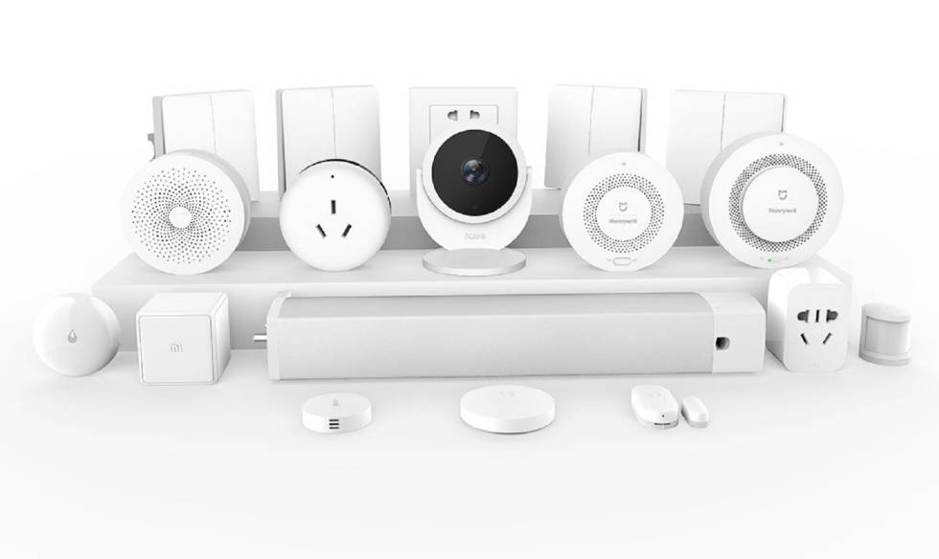
Devices, or Things
Products
Lights
Blinds
Cameras
Presence detectors
Door locks
Thermostats
HVAC systems
Water detectors
Speakers
etc...
DYI
Arduino
Raspberry PI
ESP8266
RF Socket
etc…
IoT classes:
Assumed State
Cloud Polling
Cloud Push
Local Polling
Local Push

Slide 9
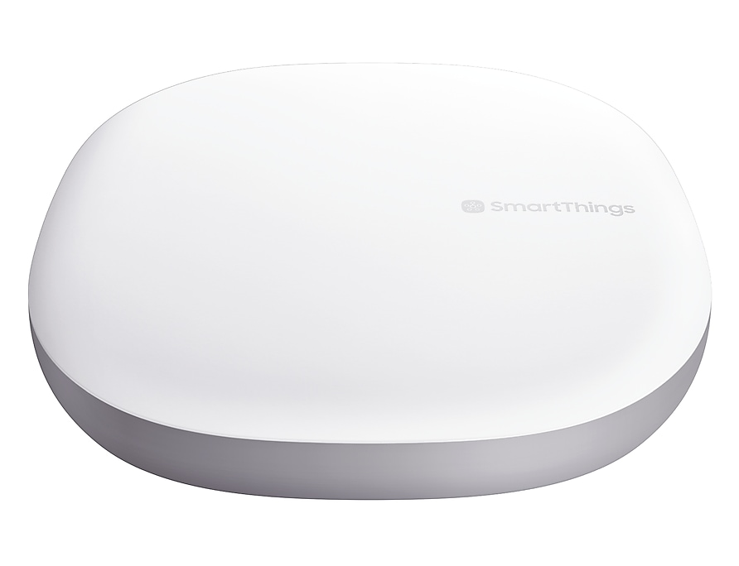
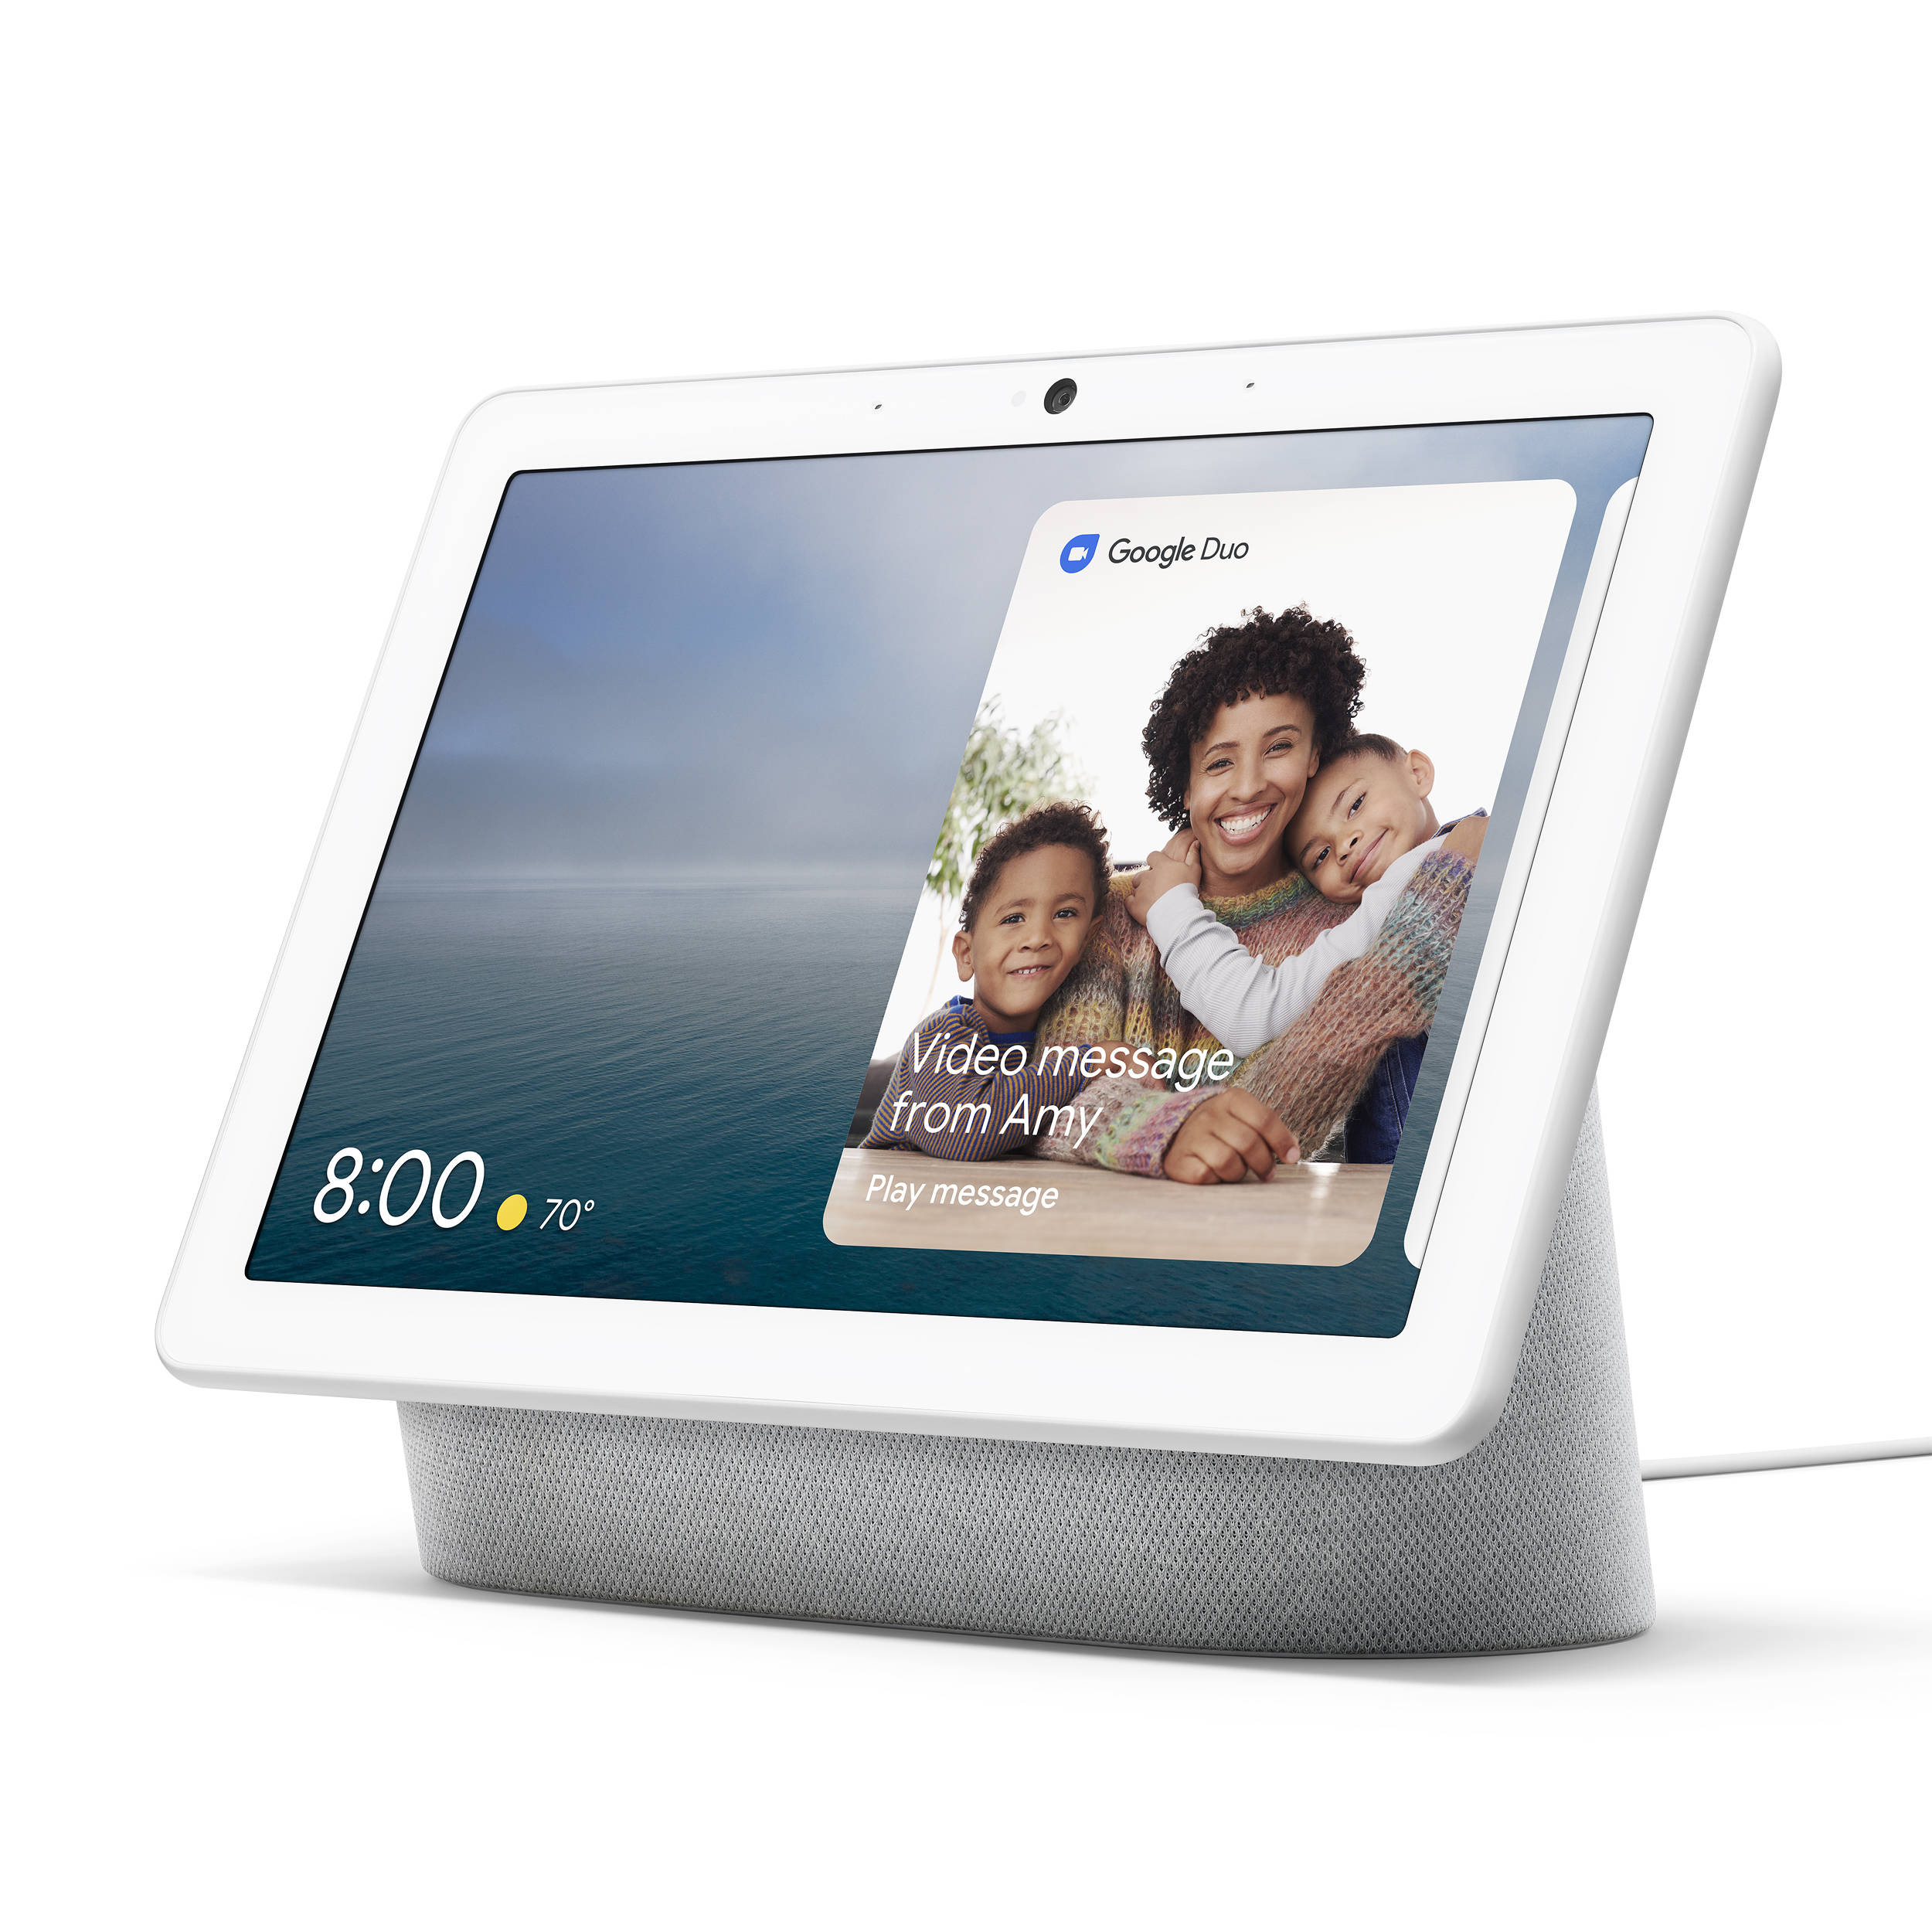
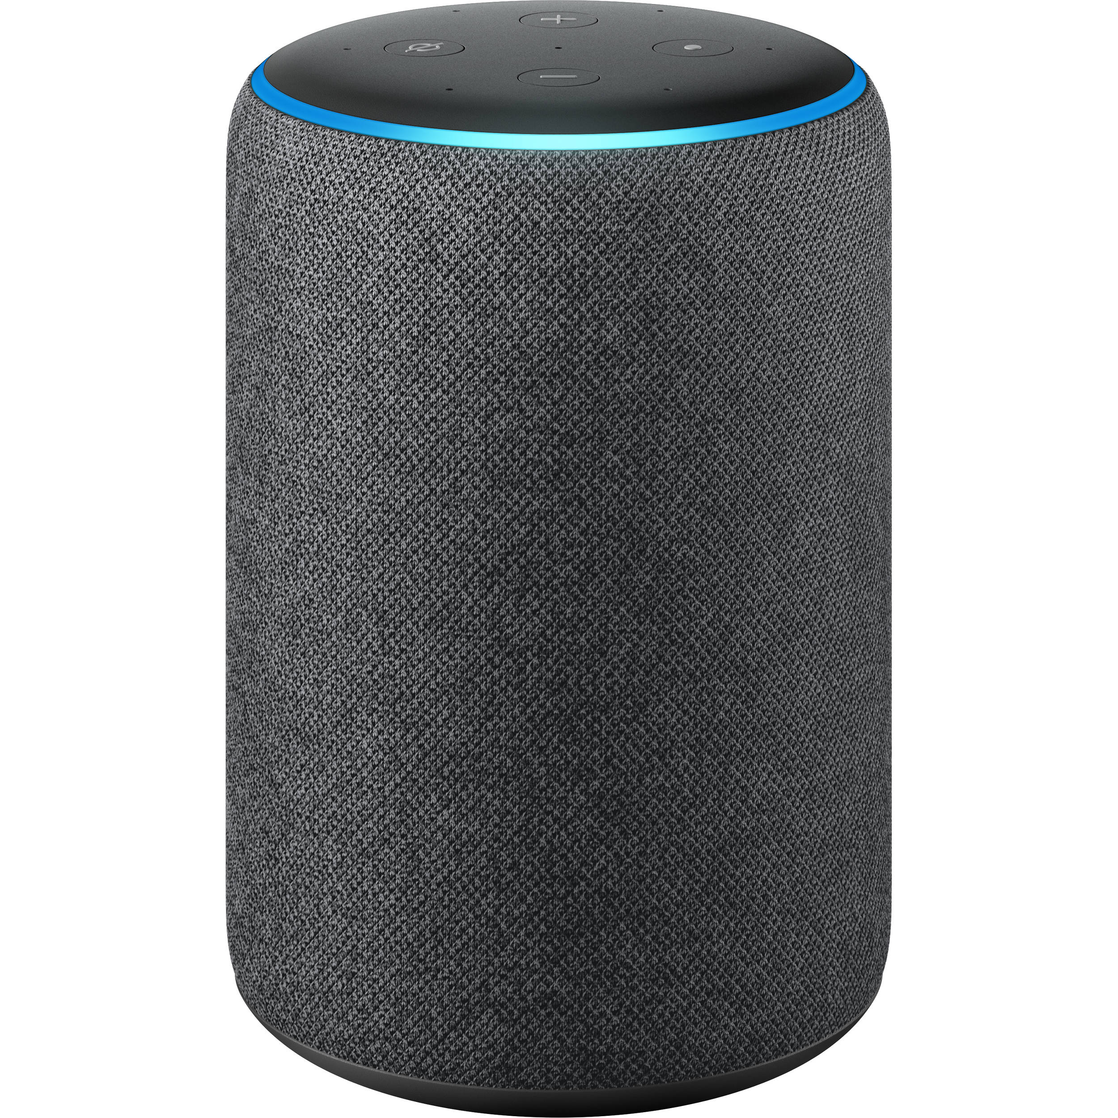
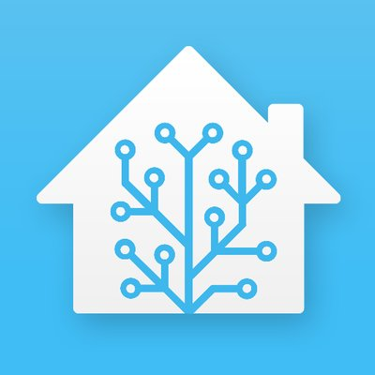


Central hub
Proprietary software, e.g.:
Samsung SmartThings
Google Home or Nest Hub
Amazon Echo
Open source software, e.g.:
Home Assistant
OpenHAB
Domoticz

Slide 10
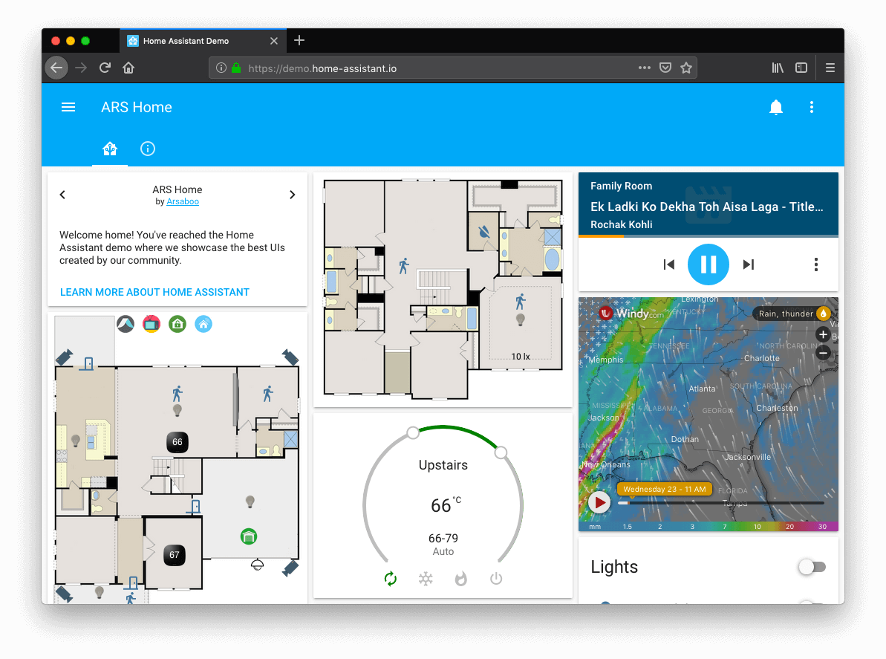
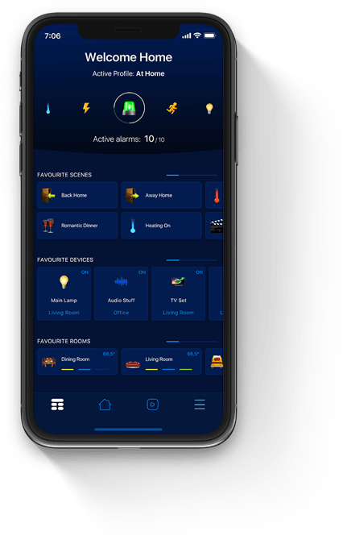
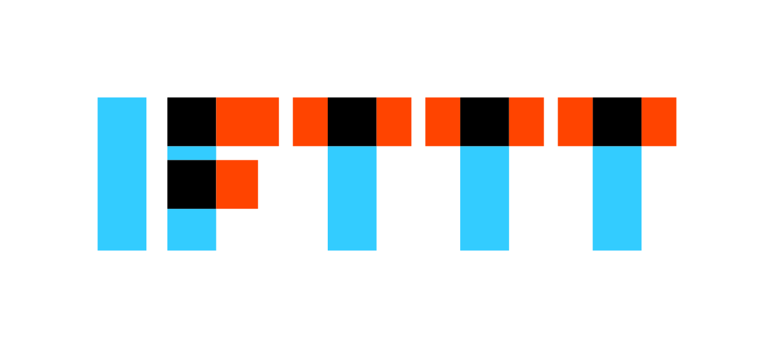

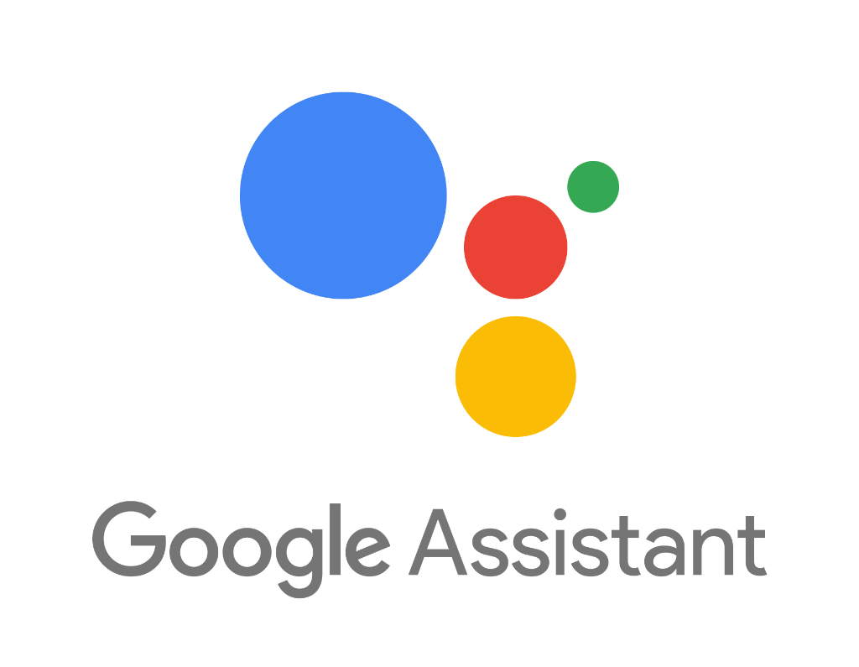

UI
Web apps
Mobile apps
Voice assistants, e.g.:
Google Home
Amazon Alexa
Automation systems, e.g.:
IFTTT
Node-RED

Slide 11
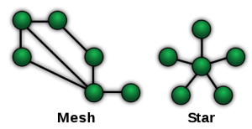
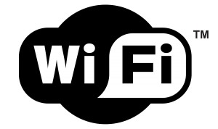


Protocols
Topology | Star | Mesh | Mesh
Standard | IEEE 802.11 | Z-Wave Alliance proprietary | IEEE 802.15.4
Frequency | 2.4 - 5 GHz | 865 - 926 MHz | 2.4 GHz
Transfer rate | > 1 GB/s | 20-40 KB/s | 20-250 KB/s
Range | 10-30 m | 35-100 m | 10-30 m
Power consumption | High | Very low | Very low
Encryption | AES 128 | AES 128 | AES 128
Devices limit | Unlimited (theoretical) | 232 | 65.000 (theoretical)
Device cost | € | €€€ | €€

Slide 12

My home setup

Slide 13
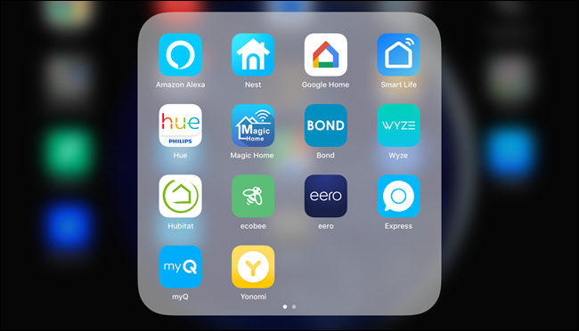
Requirements
No vendor lock-in
Single app
Single hub
Prefer Local over Cloud
data locality
Prefer push over pull
Prefer open source over proprietary
Prefer non-Wifi devices

Slide 14
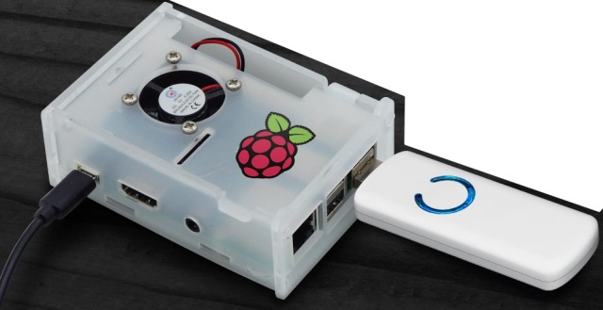
Hub
Spare Raspberry PI 2
Home Assistant (Hass.io)
Aeotec Z-Wave Z-Stick Gen5
https://www.home-assistant.io/hassio/
https://www.amazon.es/Aeotec-Adaptador-USB-GEN5-bater%C3%ADa/dp/B00YETCNOE/

Slide 15
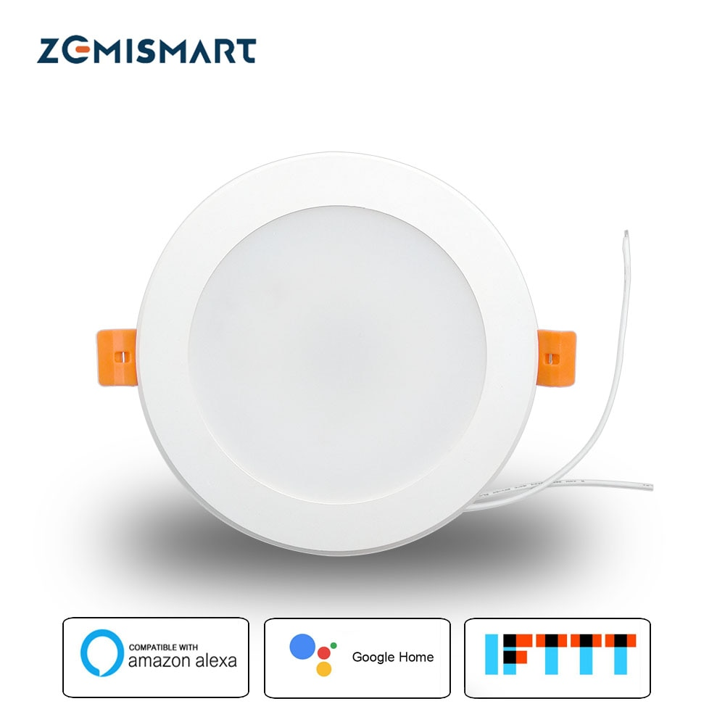
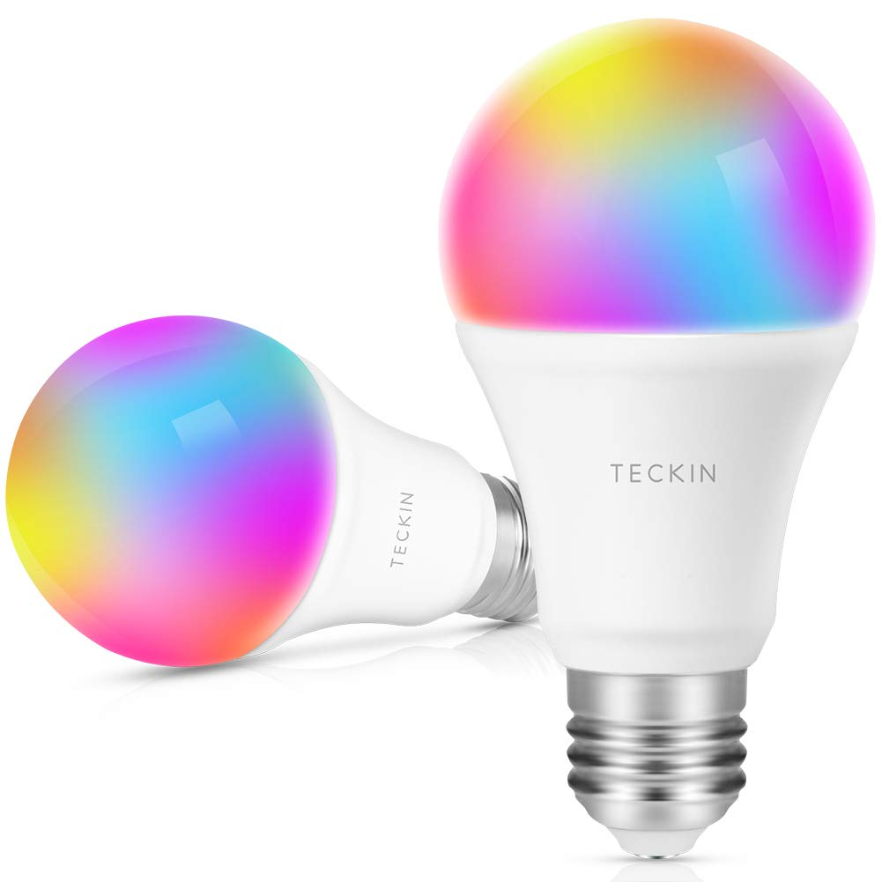
Lights
Zemismart WiFi Downlights (Tuya cloud)
TECKIN WiFi E27 bulbs (Tuya cloud)
Flashed to Tasmota firmware
MQTT protocol (local push)
https://www.aliexpress.com/item/32872319062.html
https://www.amazon.es/gp/product/B07GTHMPK5
https://github.com/ct-Open-Source/tuya-convert
https://github.com/arendst/Tasmota

Slide 16
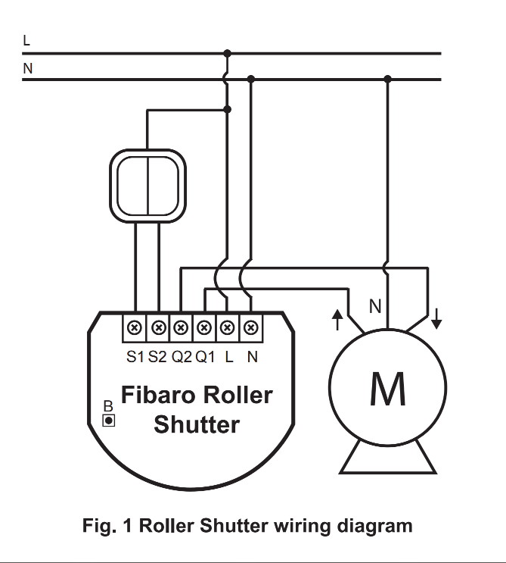
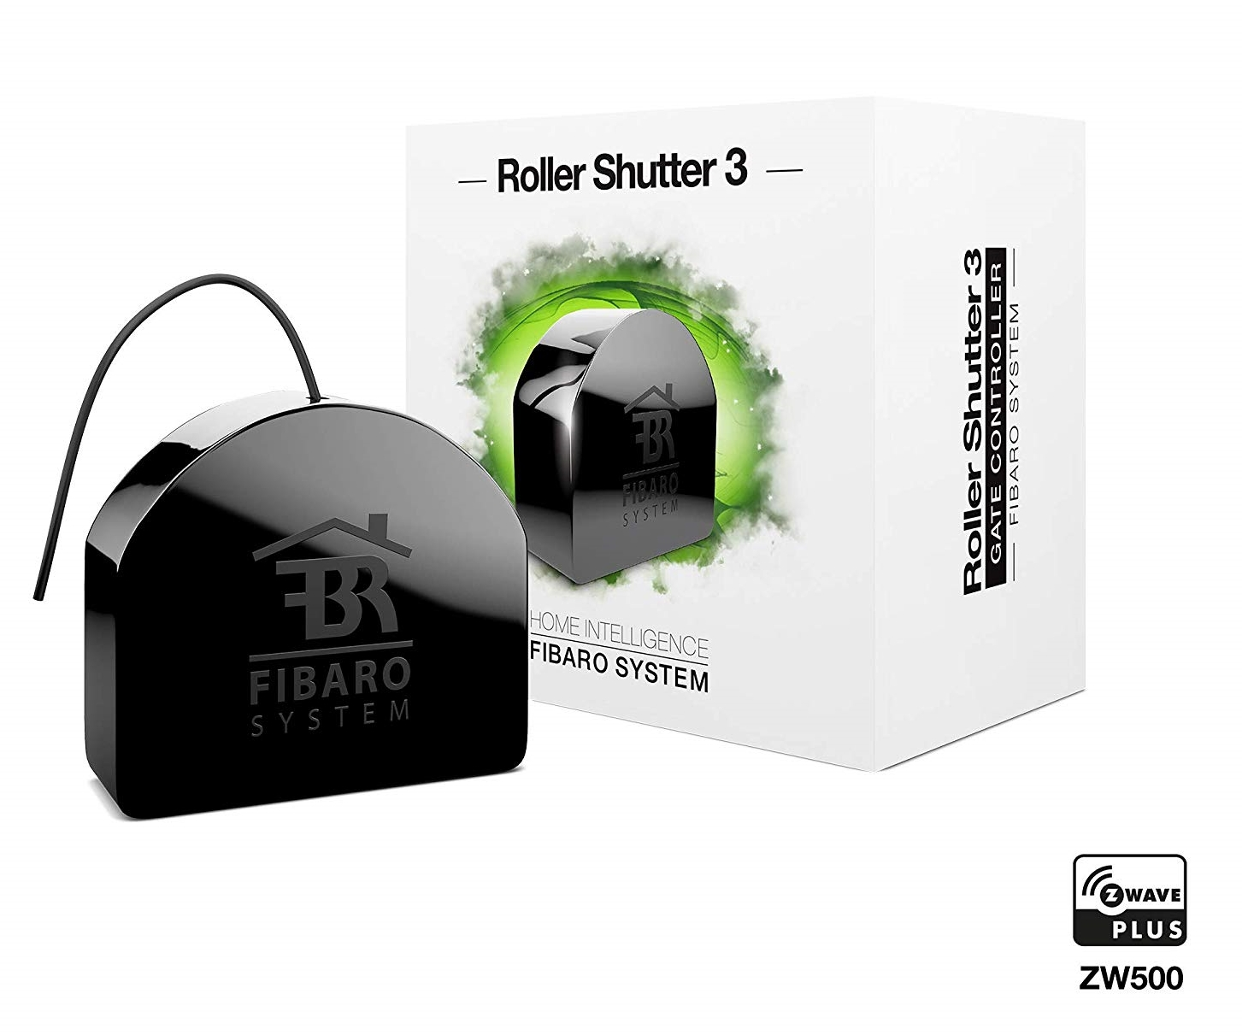
Blinds
Fibaro Z-Wave Roller Shutter 3
https://www.amazon.es/Fibaro-Roller-Shutter-Controlador-tecnolog%C3%ADa/dp/B07L5S38RN/

Slide 17
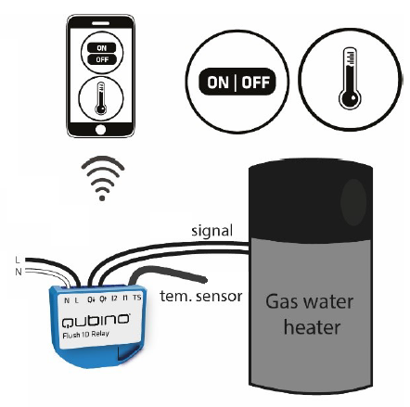
Heating
Qubino Z-Wave Flush 1D Relay
https://www.amazon.es/Qubino-ZMNHND1-Potencia-Alimentado-Oculto/dp/B01545A2DK

Slide 18
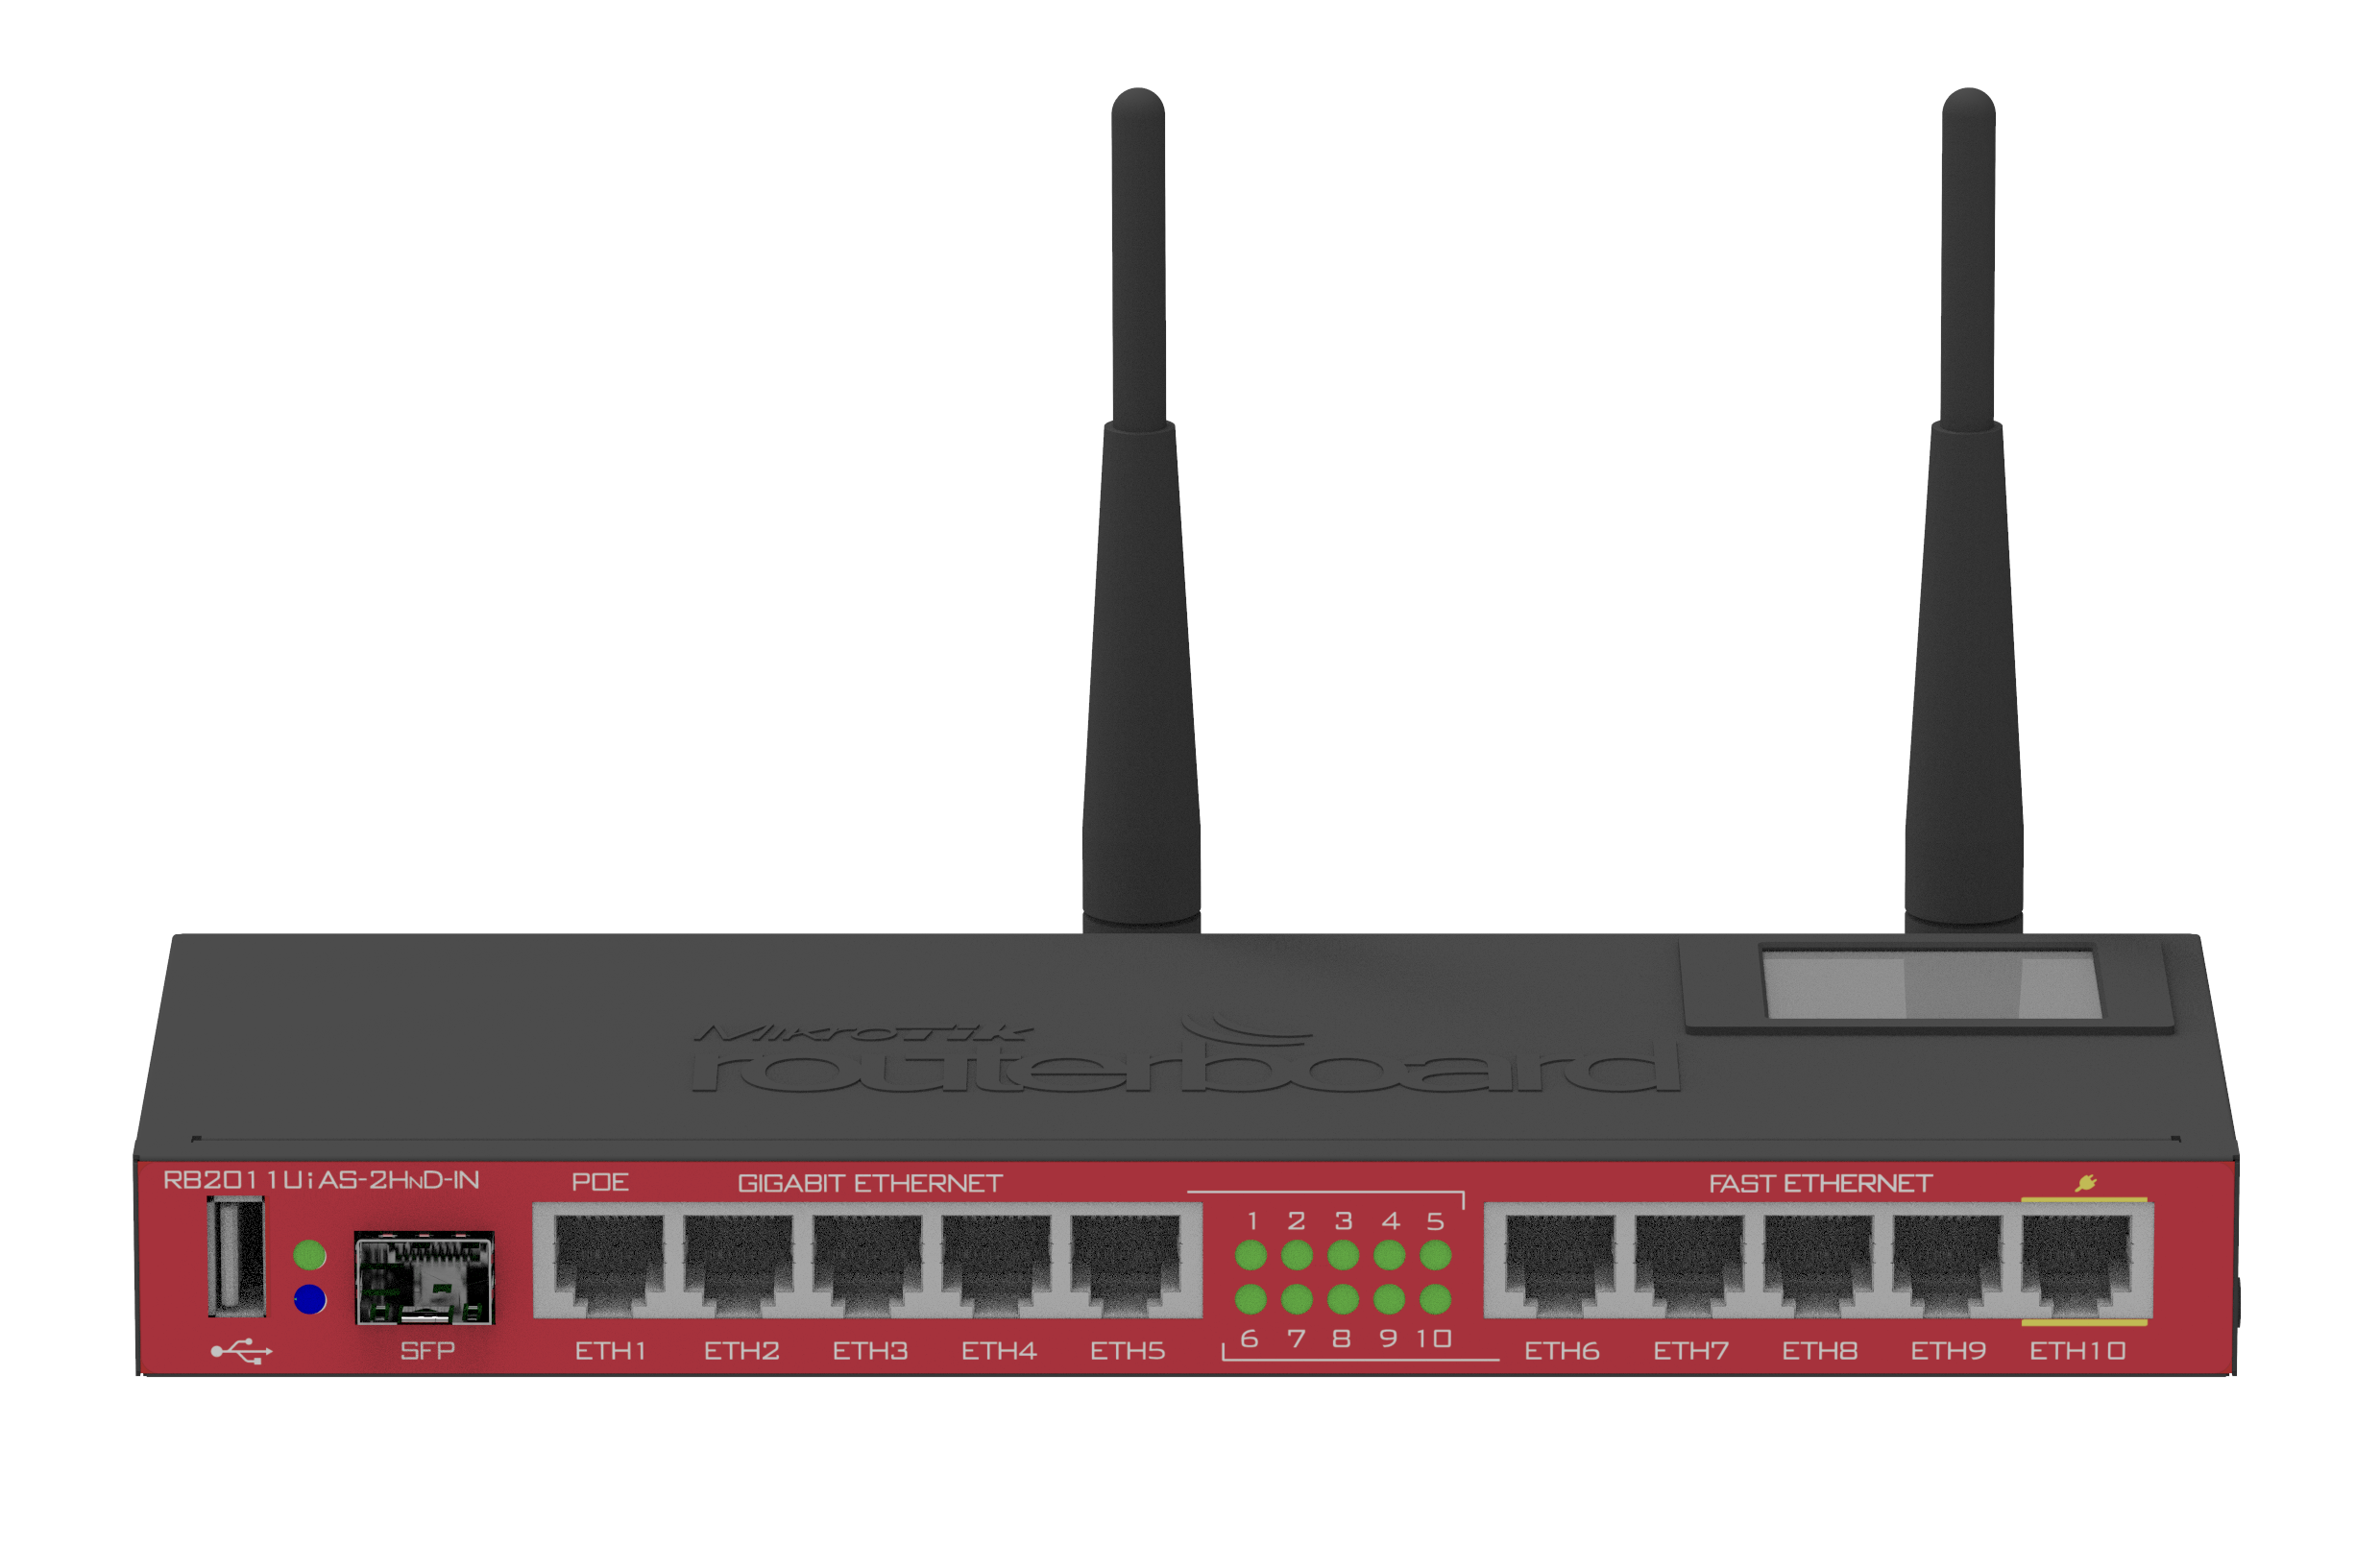
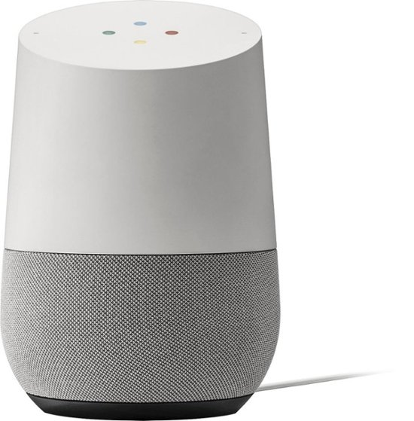

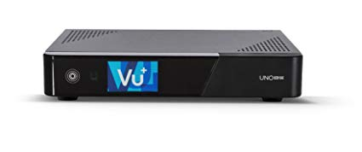
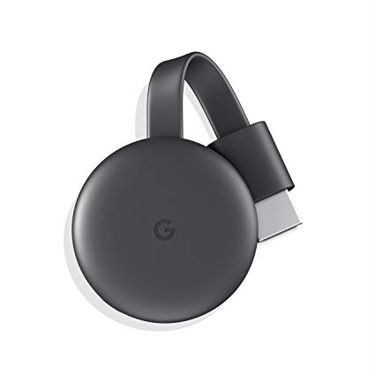

Others
Chromecast
TV
Google Home
Music
Voice commands
Set-top box
TV
OpenWeather
Sunrise and sunset
Outside weather (temp., hum., wind)
Forecast
Mikrotik router
DHCP devices

Slide 19
DEMO

Slide 20
Future work
Upgrade to Raspberry PI 4
InfluxDB and Grafana for advanced monitoring and dashboards
More sensors! (temperature, doors, windows, presence, ...)
Automations

Slide 21
Thank you!
Questions?

